Slide 1
CSE1021 PROJECT
Indian Income Tax
Calculator
A simple Python project
Vinayak Sharma | 26BAI10348
Instructor: Dr. D Lakshmi
Course code: CSE1021
Notes:
This presentation explains a beginner Python income tax calculator.

Slide 2
Introduction and Problem
• Tax is calculated in different income bands called slabs.
• Doing the calculation by hand can be confusing.
• This program asks for a salary and gives a simple tax estimate.
• It is a learning project, not a tax filing tool.
CSE102 • 02
Notes:
The project is limited to an educational estimate for the stated tax year. Tax rules used for this FY 2025-26 (AY 2026-27) educational example: https://incometaxindia.gov.in/Documents/Budget/budget-2025/faqs-budget-2025.pdf

Slide 3
Functional Requirements
1. Salary input
Enter yearly salary
and check the value
2. Tax calculation
Apply deduction, slabs,
rebate, relief, and cess
3. Result display
Show taxable income
and estimated tax
The user enters one salary. The program calculates and displays the result.
CSE102 • 03

Slide 4
Non-functional Requirements
• Easy to use: prompts and results use simple words.
• Reliable: checks for invalid or negative salary input.
• Fast: calculates one result in a short time.
• Private: does not save the salary or personal details.
• Easy to maintain: comments explain the main calculation steps.
CSE102 • 04

Slide 5
Tax Rules Used
The program uses the new tax regime for FY 2025-26 (AY 2026-27).
• Up to ₹4 lakh: 0%
• ₹4–8 lakh: 5%
• ₹8–12 lakh: 10%
• ₹12–16 lakh: 15%
• ₹16–20 lakh: 20%
• ₹20–24 lakh: 25%
• Above ₹24 lakh: 30%
Salary deduction: up to ₹75,000 | Cess: 4% | Rebate up to ₹12 lakh taxable income for eligible residents
CSE102 • 05
Notes:
Tax rules used for this FY 2025-26 (AY 2026-27) educational example: https://incometaxindia.gov.in/Documents/Budget/budget-2025/faqs-budget-2025.pdf The Department's Budget FAQ also explains marginal relief just above ₹12 lakh.

Slide 6
System Architecture
The program works in a simple sequence:
Salaried
user
Python
program
Tax estimate
Tkinter GUI result window
Input salary → calculate tax → show the result
The program does not use a database or save salary details.
CSE102 • 06

Slide 7
Use Case Diagram
Enter yearly
salary
Salaried
user
View tax
estimate
User goal: get an estimated tax result.
CSE102 • 07

Slide 8
Workflow Diagram
Start
Enter salary
Check input
Calculate tax
Show result
End
If the input is not a valid non-negative number, the program shows an error and stops.
CSE102 • 08

Slide 9
Sequence Diagram
User
Program
Tax calculation
Terminal
1. Enter salary
2. Calculate slabs and relief
3. Return tax estimate
4. Print result
CSE102 • 09

Slide 10
Program Parts and Data Storage
Main parts inside the Python program
Salary input
and check
Tax slab
calculation
Result
display
All parts are in the beginner's Python program.
No database is used, so an ER diagram is not needed.
CSE102 • 10

Slide 11
Design Decisions
• Use Tkinter for a graphical interface
• Use progressive slabs because each rate applies to part of the income.
• Use min() to stop each slab at its upper limit.
• Do not save salary data because the program only needs one calculation.
• Show the standard deduction and taxable income so the result is easier to follow.
CSE102 • 11

Slide 12
Introduction to Tkinter
Tkinter is Python's standard library for creating graphical user interfaces (GUIs).
It allows users to interact with the program through windows, buttons, labels, and input fields.
The project uses Tkinter to make income tax calculation easier and more user-friendly.
Users can calculate tax without entering commands in the terminal.
GUI Components Used
Component | Purpose
Tk() | Creates the main window
Label | Displays headings and results
Entry | Accepts annual salary
Button | Performs calculation and exit
messagebox | Displays input errors
StringVar() | Updates calculation results
CSE102 • 11

Slide 13
Implementation Details
Python ideas used
• input() and float()
• Variables
• if statements
• Arithmetic
• min()
• Formatted output
Tkinter
Run the program
1. Open the folder in VS Code.
2. Open Terminal → New Terminal.
3. Type: python code.py
4. Enter salary in rupees.
CSE102 • 12

Slide 14
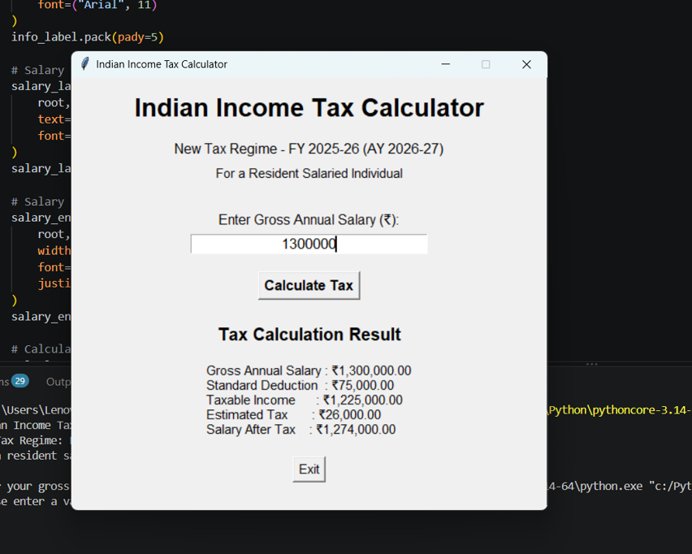
Screenshots and Sample Results
Example: gross salary ₹13,00,000
Gross salary ₹13,00,000
Standard deduction ₹75,000
Taxable income ₹12,25,000
Tax after marginal relief ₹25,000
Cess (4%) ₹1,000
Estimated total tax ₹26,000
.
CSE102 • 13
Notes:
Tax rules used for this FY 2025-26 (AY 2026-27) educational example: https://incometaxindia.gov.in/Documents/Budget/budget-2025/faqs-budget-2025.pdf The figures are an example based on the slab rates, marginal relief, and 4% cess.

Slide 15
Testing Approach and Challenges
Suggested checks (run them in VS Code)
₹12,75,000 salary → expected tax ₹0
₹13,00,000 salary → expected tax ₹26,000
₹15,00,000 salary → expected tax ₹97,500
Text input or negative value → show an error
Main challenges
• Applying each slab to the correct part of income.
• Subtracting the deduction before tax.
• Understanding rebate and marginal relief.
CSE102 • 14

Slide 16
Learnings and Future Enhancements
What I learned
Possible future changes
• Read user input
• Use variables and calculations
• Apply if statements
• Print clear results
• Add more types of income
• Add automatic tests
• Update tax rules for a later year
CSE102 • 15

Slide 17
References
Official sources used for the tax rules
1. Income Tax Department, Government of India
Budget 2025 FAQs: slabs, rebate, marginal relief, and examples
incometaxindia.gov.in/Documents/Budget/budget-2025/faqs-budget-2025.pdf
2. Income Tax Department
Salaried Individuals for AY 2026-27
incometax.gov.in/iec/foportal/help/individual/return-applicable-1
Tax rules can change. This project is an educational estimate only.
CSE102 • 16
Notes:
References:
https://incometaxindia.gov.in/Documents/Budget/budget-2025/faqs-budget-2025.pdf
https://www.incometax.gov.in/iec/foportal/help/individual/return-applicable-1

